Slide 1
Data Structures and Algorithms CS2002
Algorithms

Slide 2
Algorithm Types
Algorithm types we will consider include:
  Simple recursive algorithms
  Backtracking algorithms
  Divide and conquer algorithms
  Dynamic programming algorithms
  Greedy algorithms
  Branch and bound algorithms
  Brute force algorithms
  Randomized algorithms

Slide 3
Greedy algorithms
An optimization problem is one in which you want to find, not just a solution, but the best solution
A “greedy algorithm” sometimes works well for optimization problems
A greedy algorithm works in phases: At each phase:
  You take the best you can get right now, without regard for future consequences
  You hope that by choosing a local optimum at each step, you will end up at a global optimum

Slide 4
Example: Counting money
Suppose you want to count out a certain amount of money, using the fewest possible bills and coins
A greedy algorithm would do this would be:
At each step, take the largest possible bill or coin that does not overshoot
  Example: To make $6.39, you can choose:
    a $5 bill
    a $1 bill, to make $6
    a 25¢ coin, to make $6.25
    A 10¢ coin, to make $6.35
    four 1¢ coins, to make $6.39
For US money, the greedy algorithm always gives the optimum solution

Slide 5
Example: Dijkstra’s shortest path algorithm
It is a solution to single source, all-destinations, shortest path problem
In each stage of the algorithm a shortest path to a new destination is generated. The destination vertex for the next shortest path is selected using the greedy criterion: From the vertices to which a shortest path has not been generated select one that results in the least path length.

Slide 6
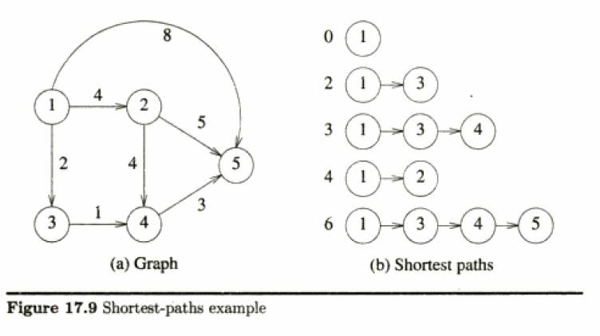

Slide 7
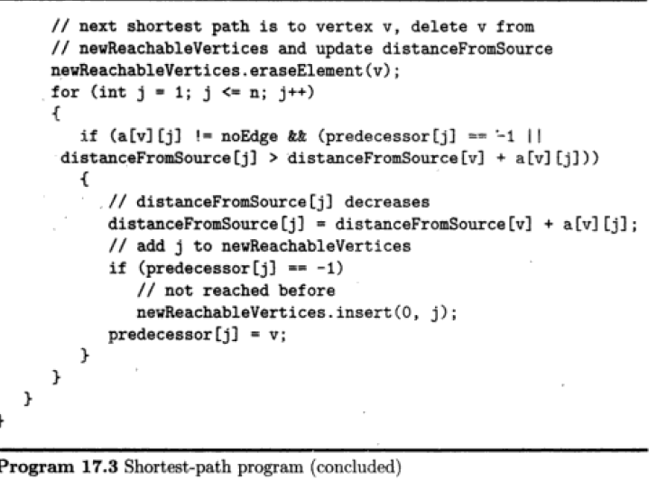

Slide 8
Minimum Cost Spanning tree
Every spanning tree of an undirected Graph with n vertices will have n-1 edges.
The problem is to select the n-1 edges in a way to give the minimum-cost spanning tree of Graph G.

Slide 9
Kruskal’s Greedy algorithm to find MST
Kruskal’s algorithm selects the n-1 edges one at a time using the greedy criterion: From the remaining edges, select a least-cost edge that does not result in a cycle when added to the set of already selected edges.
Kruskal's algorithm:
    sort the edges of G in increasing order by length
    keep a subgraph S of G, initially empty
    for each edge e in sorted order
    if the endpoints of e are disconnected in S add e to S
    return S

Slide 10
Divide and Conquer
A divide and conquer algorithm consists of two parts:
  Divide the problem into smaller subproblems of the same type, and solve these subproblems recursively
  Combine the solutions to the subproblems into a solution to the original problem
Traditionally, an algorithm is only called divide and conquer if it contains two or more recursive calls

Slide 11
Divide & Conquer Example: Quick Sort
(ref 7.3 Data Structures in C++)
The quick sort scheme developed by C. A. R. Hoare has the best average behavior among all the sorting methods we shall be studying
Given (R₀, R₁, …, R_{n-1}) and K_{i} denote a pivot key
If K_{i} is placed in position s(i),
then K_{j} ≤ K_{s(i)} for j < s(i), K_{j} ≥ K_{s(i)} for j > s(i).
After a positioning has been made, the original file is partitioned into two subfiles, {R₀, …, R_{s(i)-1}}, R_{s(i)}, {R_{s(i)+1}, …, R_{s(n-1)}}, and they will be sorted independently

Slide 12
Quick Sort
Quick Sort Concept
  select a pivot key
  interchange the elements to their correct positions according to the pivot
  the original file is partitioned into two subfiles and they will be sorted independently

Slide 13
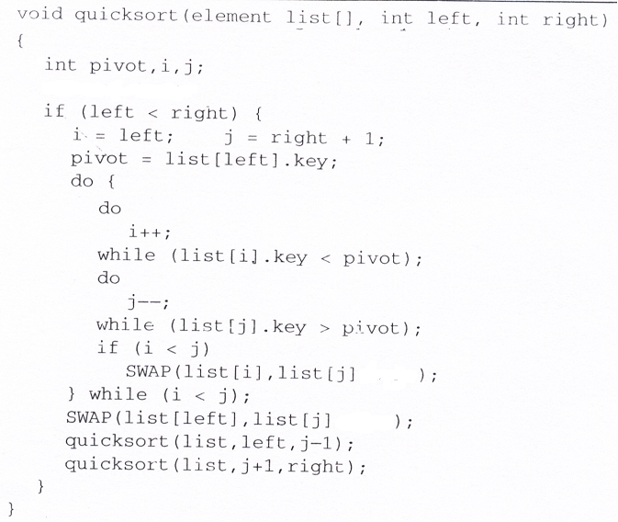
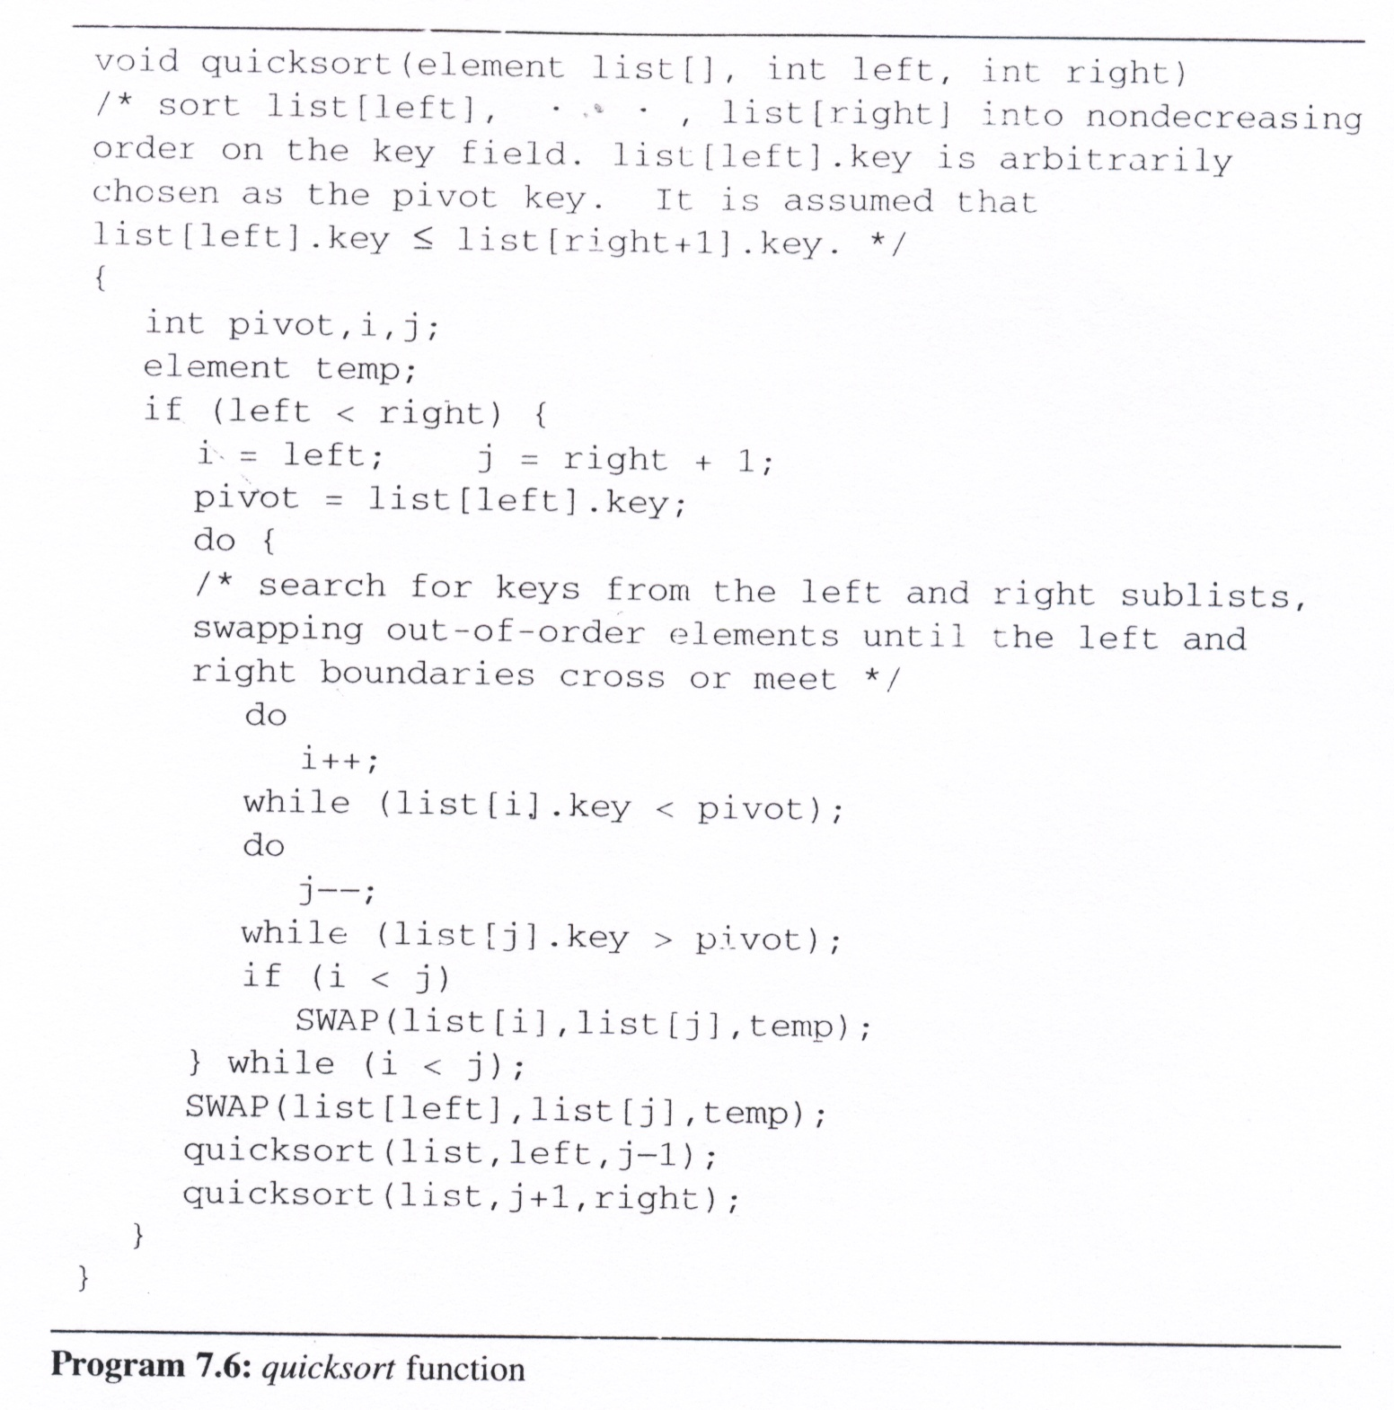
Quick Sort Program

Slide 14
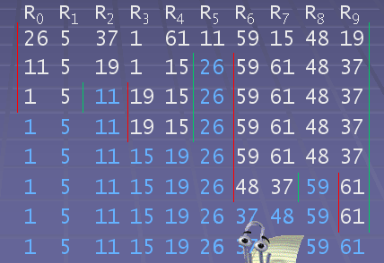
Left =0, right=9
Left =0, right=4
Left =0, right=1
Left =3, right=4
Left =6, right=9
Left =6, right=7
Left =9, right=9

Slide 15
Analysis for Quick Sort
  Assume that each time a record is positioned, the list is divided into roughly the same size of two parts.
  Position a list with n element needs O(n)
  T(n) is the time taken to sort n elements
  T(n)<=cn+2T(n/2) for some c
  <=cn+2(cn/2+2T(n/4))
  ...
  <=cnlog₂n+nT(1)=(nlogn)
Time complexity
  Average case and best case: (nlogn)
  Worst case: O(n²)
  Best internal sorting method considering the average case
Unstable

Slide 16
Lemma 7.1:
  Let T_{avg}(n) be the expected time for quicksort to sort a file with n records. Then there exists a constant k such that T_{avg}(n) ≤ knlog_{e}n for n ≥ 2
Stack space complexity:
  Average case and best case: O(logn)
  Worst case: O(n)

Slide 17
Homework
Show how Quick sort would work for the following sequence of numbers
19 7 32 2 68 13 58 17 46 17

Slide 18
Heap Sort
The challenges of merge sort
  The merge sort requires additional storage proportional to the number of records in the file being sorted.
  By using the O(1) space merge algorithm, the space requirements can be reduced to O(1), but significantly slower than the original one.

Slide 19
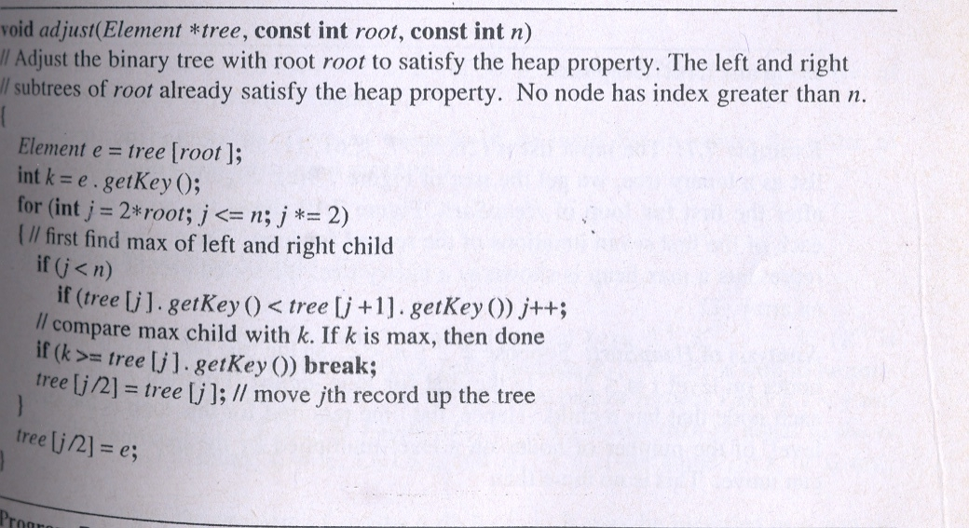
Heap Sort
adjust
  adjust the binary tree to establish the heap
  This function takes a binary tree T, whose left and right subtrees satisfy the heap property but whose root may not, and adjusts T so that the entire binary tree satisfies the heap property

Slide 20
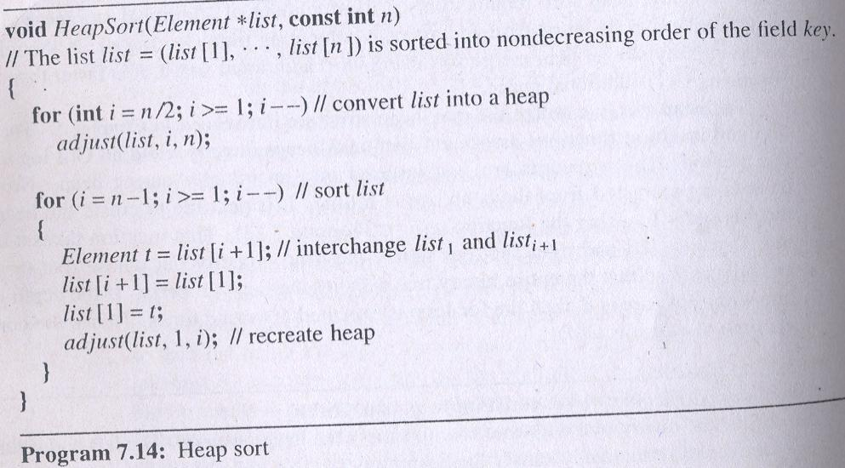
Heap Sort
To sort a list in ascending order, we first create a max heap (in a bottom
up manner) by using the adjust function repeatedly. Next we make n-1
passes over the list exchanging the first record in the heap with the last.
Since the first record always contains the highest key, this record is now
in its sorted position. We then decrement the heap size and readjust the
heap

Slide 21
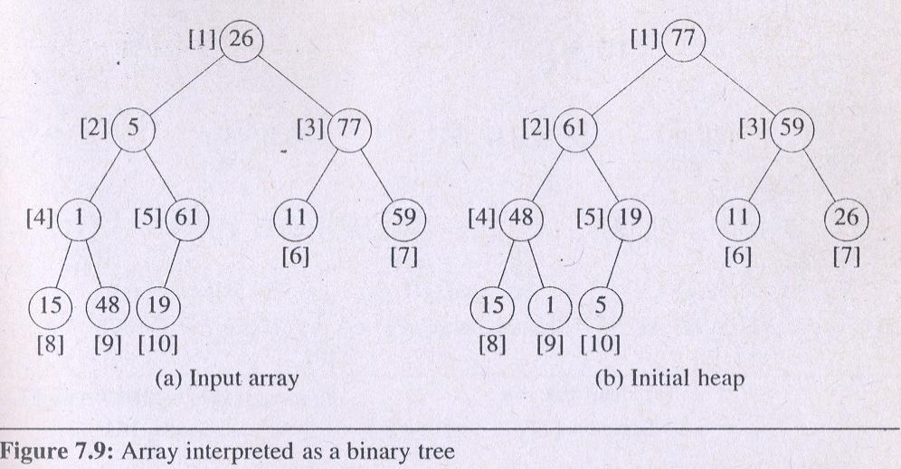
Heap Sort Example:
Input list : 26, 5, 77, 1, 61, 11, 59, 15, 48, 19

Slide 22
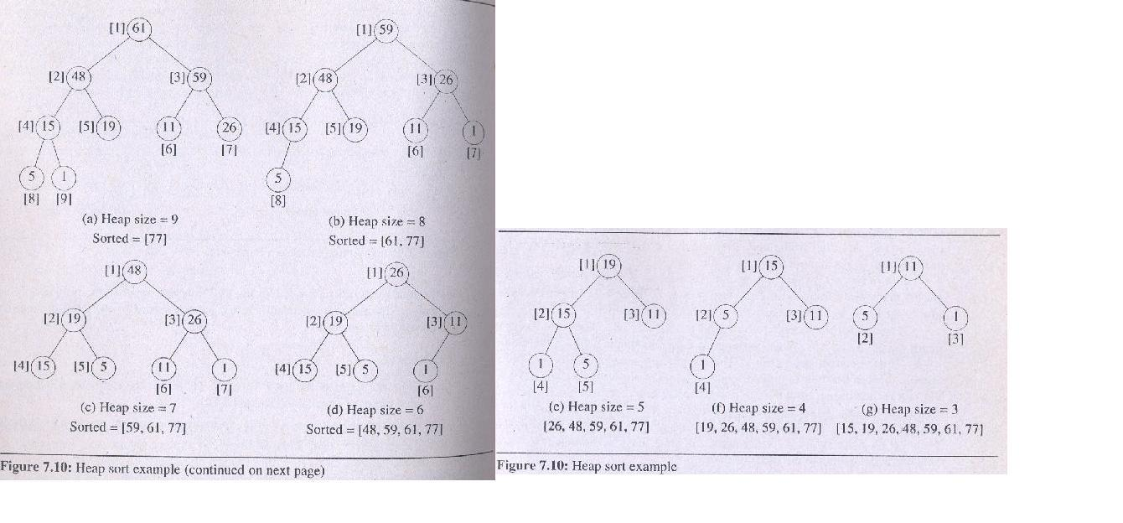
Heap Sort Example contd..

Slide 23
Heap Sort Analysis
  O(n log n)
  In place
  Unstable

Slide 24
Merge Sort
(ref 7.5 Data Structures in C++)
Before looking at the merge sort algorithm to sort n records, let us see how one may merge two sorted lists to get a single sorted list.
Merging
  The first one, Program 7.7, uses O(n) additional space.
  It merges the sorted lists
  (list[i], … , list[m]) and (list[m+1], …, list[n]),
  into a single sorted list, (sorted[i], … , sorted[n]).

Slide 25
public void merge(int[] initList, int[] mergedList, int left, int m, int n)
{
int i1 = left, iResult =left, i2 = m+1;
for( ; i1<=m && i2<=n; iResult++)
{ if(initList[i1]<= initList[i2])
{
mergedList[iResult] = initList[i1];
i1++;
}
else
{
mergedList[iResult] = initList[i2];
i2++;
}
}
if(i1>m)
{
for(int t=i2; t<=n; t++)
mergedList[iResult +t -i2]=initList[t];
}
else
{
for(int t=i1; t<=m; t++)
mergedList[iResult +t -i1]=initList[t];
}
}

Slide 26
Iterative Merge Sort
  We assume that the input sequence has n sorted lists, each of length 1.
  We merge these lists pairwise to obtain n/2 lists of size 2.
  We then merge the n/2 lists pairwise, and so on, until a single list remains.
  4. It works bottom-up

Slide 27
void MergeSort(Element *list, const int n)
{
Element *tempList = new Element[n];
for (int l =1; l<n; l*=2)
{
MergePass(list, tempList, n, l );
l = l *2;
MergePass(tempList, list, n, l )
}
delete tempList;
}
void MergePass(Element *initlist, Element *resultlist, const int n,
const int l)
{
for (int i =1; i<=n-2*l+1; i=i+2*l)
{
merge(initList, resultList, i, i+l-1;i+2*l-1);
}
if((i+l -1)< n) merge(initList, resultList, i, i+l-1;n);
else
for(int t=i; t<=n; t++)
resultList[t] = initList[t];
}

Slide 28
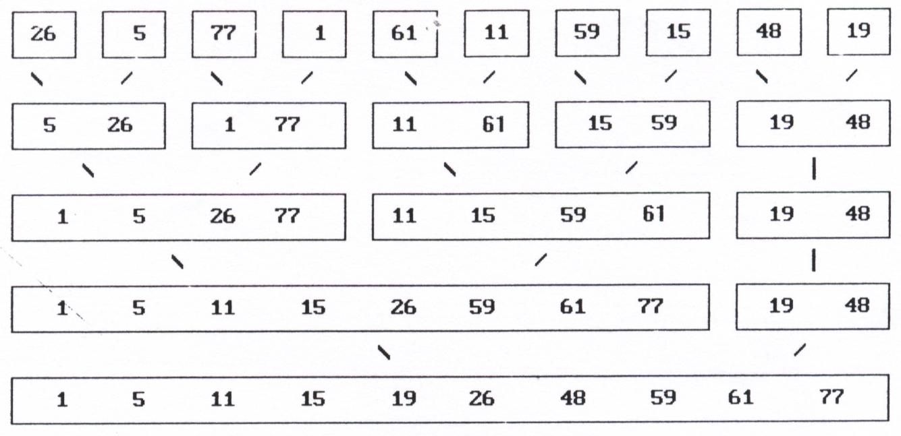
initList
resultList
initList
resultList
initList

Slide 29
Analysis
  Total number of passes is the ceiling of log₂n
  merge two sorted list in linear time: O(n)
  The total computing time is O(n log n) in all cases.
  Stable ( depending on underlying merge)
  Not-in-place

Slide 30
Recursive Merge Sort (arrays)
(works top down) similar to the one given in Program 7.11 for linked lists
void rmergesort(Element *a, int left, int right)
{
if(right <= left) return;
int mid = (right +left)/2;
rmergesort(a, left, mid);
rmergesort(a, mid+1, right);
merge( a, left, mid, right);
}

Slide 31
Homework
Show how the basic mergesort that we saw in class would work on the following array of numbers
15 8 7 2 3 6 9 10 1 11 12 0 4 5 13 14

Slide 32
Merge (linked lists) similar to the one given in Program 7.12
Node ListMerge(Node a, Node b) // first nodes of the 2 sorted linked blists
{
Node dummy= new Node();
Node head = dummy, c = head;
for(; a!=null && b!=null;)
{ if (a.item < =b.item)
{
c.next = a; c=a; a=a.next;
}
else
{
c.next = b; c=b; b=b.next;
}
}// end of for loop
if ( a == null) c.next =b;
else c.next = a;
head= head.next; delete dummy; return head;
}

Slide 33
MergeSort (linked lists) similar to the one given in Program 7.11 for linked lists
Node ListMergesort(Node c)
{
if ( c== null || c.next == null) return c;
Node a=c, b=c.next;
// divide the list in half (different mechanism in book)
while ((b!=null) && (b.next !=null))
{
c= c.next ; b =(b.next).next;
}
b=c.next ; c.next = null;
return ListMerge(ListMergesort(a), ListMergesort(b));
}

